Slide 1
Pre course setup
1. install OpenVPN : Link
2. go to HERE to get OpenVPN
3. load Configurable file and DONE!!!
( login with GPU Server Account )

Slide 2
Introduction to docker
Credits to Meng, Shane
By BT

Slide 3
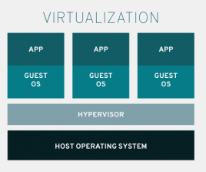
Virtualization
Allows multiple simulated environments or dedicated resources from a single hardware
Hardware independent( as long as it runs the virtualized environment )
Higher utilization
Notes:
https://www.redhat.com/en/topics/virtualization

Slide 4
Containers
Linux containers
a OS level virtualization method for running multiple isolated Linux systems on one Linux kernel.
Docker
Automates the deploy of applications
Guarantees that it will always run the same regardless of the environment // same architecture
* For what?
Linux kernel provides
Cgroup
Limitation and prioritization of resources
Namespace
Allows complete isolation of an applications’ view of the OS
Including process tree, networking, mounted file system

Slide 5
Install docker CE on linux
sudo apt-get remove docker docker-engine docker.io containerd runc # remove any existing docker
sudo apt-get update
sudo apt-get install apt-transport-https ca-certificates curl gnupg-agent software-properties-common
curl -fsSL https://download.docker.com/linux/ubuntu/gpg | sudo apt-key add -
sudo add-apt-repository "deb [arch=amd64] https://download.docker.com/linux/ubuntu $(lsb_release -cs) stable“
# change arch=amd64 to other according to cpu architecture

Slide 6
Why Containers
For every service you deploy ( lets say there is X services ), and you got Y development platforms
There will be total of X * Y combinations!!
If those combinations runs on different library … ?
Think of how objects are shipped
You gets all kinds of sizes and shapes, and multiple transportation tools … ( looks like the question above )
Build a standard container!!
Container’s goodness
Portable
No more missing dependencies
Libraries are in ISOLATED containers, so various versions can coexist on the same machine.
Notes:
In side the container and outside of the container

Slide 7

Why Containers ( vs Virtual Machines )
1. shared binaries and libraries
Consider you are trying apps, each running in its own environment
Copy On Write characteristics
Modified APPs
APP
APP
APP
Original + delta
LIB
LIB
LIB
Share library
Share container
APP
APP
APP
OS
OS
OS
LIB
Modified LIBs
LIB
LIB
APP
APP
APP
LIB
LIB
LIB
Hypervisor ( VM ) / docker daemon

Slide 8
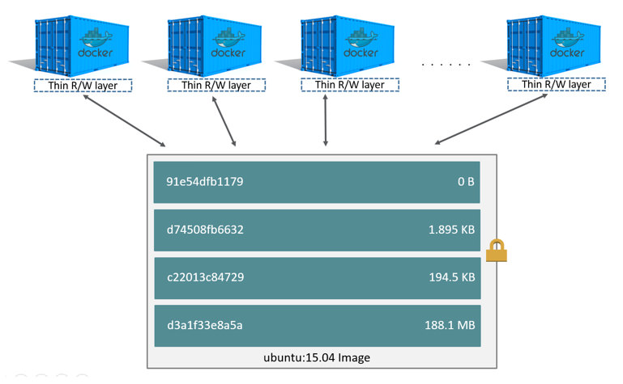
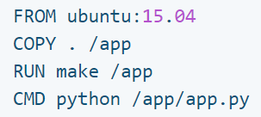
Images, Containers, and Storage drivers
A docker image is build up from a series of layers, each presents an instruction in the image’s Dockerfile, each layer except the last layer is Read-only.
Container size on disk
Size : the disk used for writable layer
Virtual size : the amount of data for the read-only combined with writable layer

Slide 9
Docker commands
Docker run
Start a container from a image
( images is like a virtual disk,
whereas container is more similar to a running os )
Docker ps
Show processes
Docker start / stop / restart
Start or stop a container
Docker build
Build a image from Dockerfile
Docker rm
Remove a container
Docker rmi
Remove a image
Docker stats
Show resource usage of all ( running ) containers
Docker attach
Reconnect to a running container
Docker exec
Run another ( fork ) process other than the entrypoint
Options
-it : i for keep STDIN alive( interactive ), t for pseudo-tty, normally used with run / exec
-e for Environment values, read through the container’s readme ( case by case )

Slide 10
DockerFile Build your own image for scratch
INSTRUCTION
FROM :The base of the image
FROM <image>[:<tag>] [AS <name>]
WORKDIR :
WORKDIR /path/to/workdir
USER :
USER <user>[:<group>]
USER <UID>[:<GID>]
LABEL : metadata for image
RUN : execute a command
RUN <command>
RUN ["executable", "param1", "param2"]
RUN [ "sh", "-c", "echo $HOME" ]
INSTRUCTION
COPY : ( almost same as ADD ) but copy is preferred¹
COPY [--chown=<user>:<group>] <src>... <dest>
*The directory itself is not copied, just its contents.
EXPOSE : specifies the port to listen on
EXPOSE 80/tcp
EXPOSE 80/udp
CMD : provide defaults for an executing container
CMD ["executable","param1","param2"]
ENTRYPOINT : let a container run as an executable
ENTRYPOINT ["executable", "param1", "param2"]
cmd & entrypoint
ENV : environment varables
VOLUME :
VOLUME ["/data"]

Slide 11
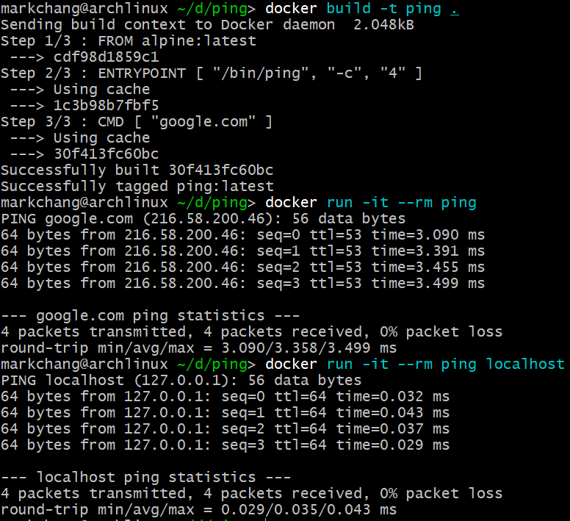
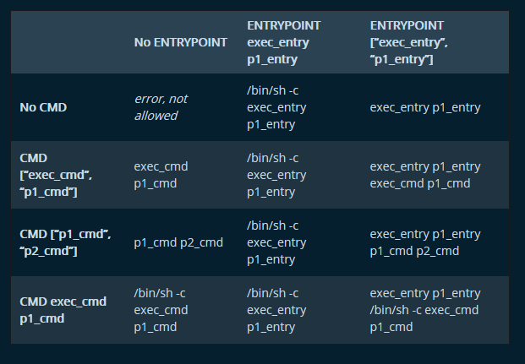
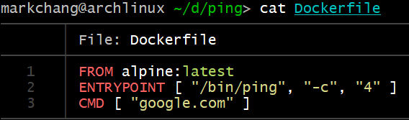
DockerFile Hello world ping example
Example 1
entrypoint
The start and end of this container, when this container is started, this command is started, when this commend stops ( either finished or being stopped ) this container stops
Best usage of entrypoint is by using brackets and quotes.
[“/bin/ping”, “-c”, “4” ] vs ping –c 4
CMD
Acts like arguments when combines with entrypoint

Slide 12
DockerFile Building with Dockerfile
Docker build [ -f /path/to/a/Dockerfile ] [ -t “name of tag” ] .
Some notices
During the building of the process, docker doesn’t know which parts of the subdirectory needs to be used, so a long waiting process will be needed if lots of files are under the building directory. Either move the Dockerfile and all necessary files to another folder or use volume instead of copying files into containers.

Slide 13
Commands in the container is not enough!!
Two normal ways you can add command to your system
Via package manager
Apt ( Ubuntu )
Pip ( python )
…
Download a precompiled binary from the internet
Most of the time, the binary are compressed along with manual
Notice!!! You need to add the executable to path
AND EXPORT DOES NOT WORK!!!
ENV to the rescue : ENV PATH=“$PATH:/path/to/new/executable”

Slide 14
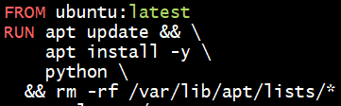

Dockerfile Add more executables
RUN [ "/bin/bash", "-c", "set -o pipefail && wget -qO- https://github.com/sharkdp/bat/releases/download/v0.11.0/bat-v0.11.0-x86_64-unknown-linux-gnu.tar.gz | tar -xz --strip 1" ]
Pipefail can help to make sure this wget successes ( this commands wget a tar.gz and unzip the file )
Always use apt clean after install to cleaup .deb files such that packages will not leave files for this build layer
During pip install, add argument –no-cache-dir for same reason ( pip install --upgrade pip && pip install --no-cache-dir matplotlib )
https://github.com/YumingChang02/dockerfile_templates

Slide 15
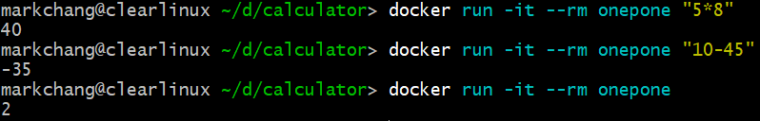
Practice time – ENTRYPOINT / CMD
Here is a sample code that does calculation via python, wrap python into a container, such that the container does the calculation for you!
* if no input is given, do one plus one

Slide 16
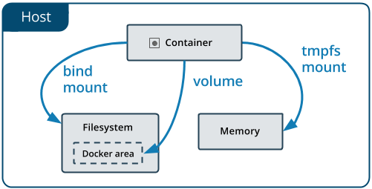
Docker volume
Docker stores data via copy on write schema thus
Overhead when dealing with heavy writes ( such as database operations )
Non persistent / shared across different container
Volume comes to play here,
By linking( mounting ) folders from the host machine ( or only in docker daemon by docker volume )
Utilizes the normal filesystem on host ( EXT4 / NTFS … )
Shared between host and container ( or container to container )

Slide 17
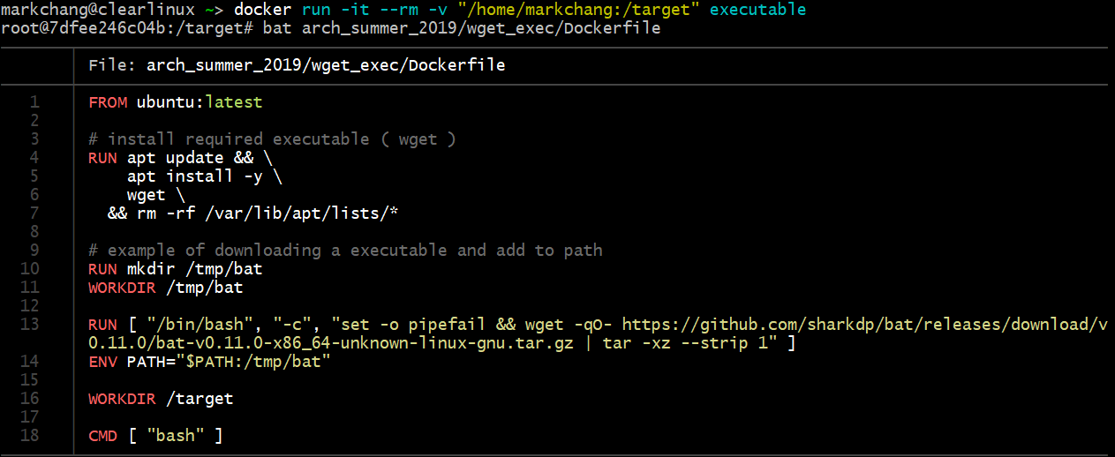
Another practice – Volume mounting
Reuse the “bat” container, now mount a folder in
Can you list the files in the mounted folder?

Slide 18
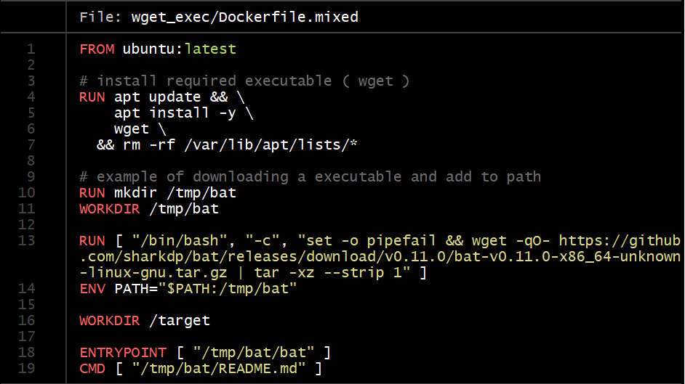
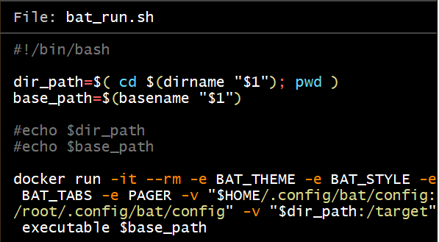
Now Lets sum everything up!!

Slide 19
References
1. using “cat” command in docker?

Slide 20
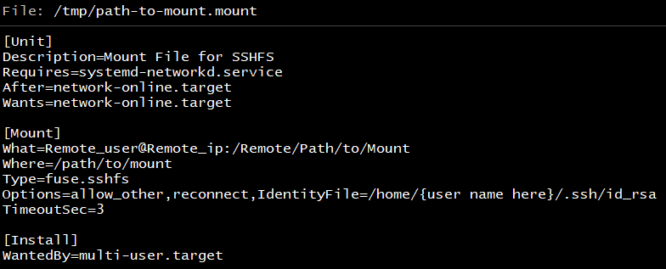
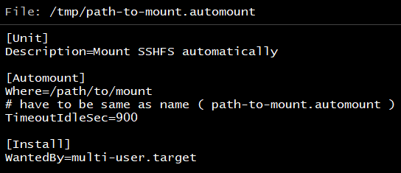
Appendix : SSHFS
sshfs : ( sudo sshfs remote_user@remote_ip:/remote/path /path/to/mount [ -o options ]
Fuse based mounting method ( remember to install fuse and add “user_allow_other” /etc/fuse.conf
Options
allow_other
Let other users other than root modify the mounted folder
IdentityFile=/home/markchang/.ssh/id_rsa
Used with ssh-copy-id ( copy ssh rsa key ) to form autologin
Can be combined with system mount file

Slide 21
Appendix : RSYNC SCP
Both are good for copying files over ssh, I prefer Rsync over scp due to its checksum ability
Usage ( both source target can be /path/to/Dest or remote_user@remote_ip:/remote/path
Rsync –avP [ -e "ssh -p port_number" ] {source} {target} / scp [-C] [-i identify_file] [-P port] [-r] {source} {target}
Rsync
-a archive, == “-rlptgoD”
-r recursive
-p preserve permissions
-t preserve modify time
-g preserve group
-o preserve owner ( may requires sudo )
-l copy symlinks as symlinks
-h human readable ( kiB, MiB … )
-H preserve hard link
-A preserve ACL
-X preserve extended attributes
-c skip based on checksum rather than time / size
--append-verify keep sending unfinished files, and check at the end in case of failed transmission / updates
Scp
-C enable compression
Use when dealing with compressible file*
-i ( use with ssh id_rsa file )
-P ( specify port )
-r recursive, ( folders )

Slide 22
Appendix : Tmux
Commands
Tmux a : attach to tmux session, if exists multiple sessions, use –t $id to connect to corresponding session
Tmux ls : list all running sessions
Inside Tmux
[Init key] + d : detach current session
[Init key] + % / [Init key] + “ : split screen
[Init key] + ↑↓←→ : change between windows
[Init key] + & : delete current window
[Init key] + x : delete current pane

Slide 23
Appendix : cron
A automatically periodically running daemon, “Run XXX every YYY time, or Run AAA every UUU”
Start cron service
crontab [–u user] [-l] [-e]
-e for editing, -l for listing
Format : min hrs day-of-month month day-of-week command
15 10 */5 * * echo “hi”

Slide 24
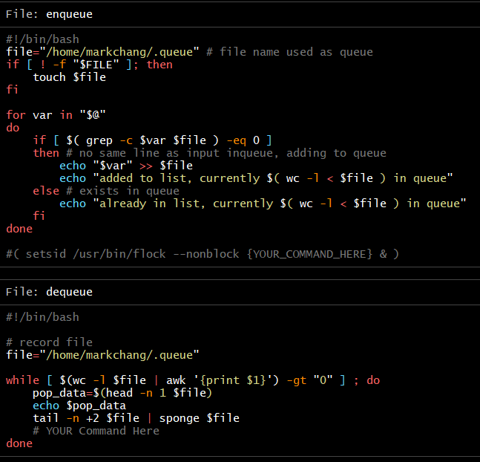
Appendix : a simple queue

Slide 25
Flock
System wide locking
You can use for loop with & to launch lots of commands, THAT RUN AT The Same TIME!!
If you wants to run a bunch of commands one by one, add flock to the start of the command!
Flock /path/to/flock/lockfile command arguments
If you want anything better
Use GNU-Parallel

Slide 26
Some reference webpage
https://explainshell.com/

